Slide 1
Applications of Machine Learning/AI

Slide 2
Agenda
Overview of artificial intelligence and machine learning
Deeper Dive into Machine Learning
Types
Common Machine Learning Algorithms
Languages of the future
Resources to get up to speed
Templates/Videos/Code Bank
Topics to explore

Slide 3
So what exactly is AI?
4

Slide 4
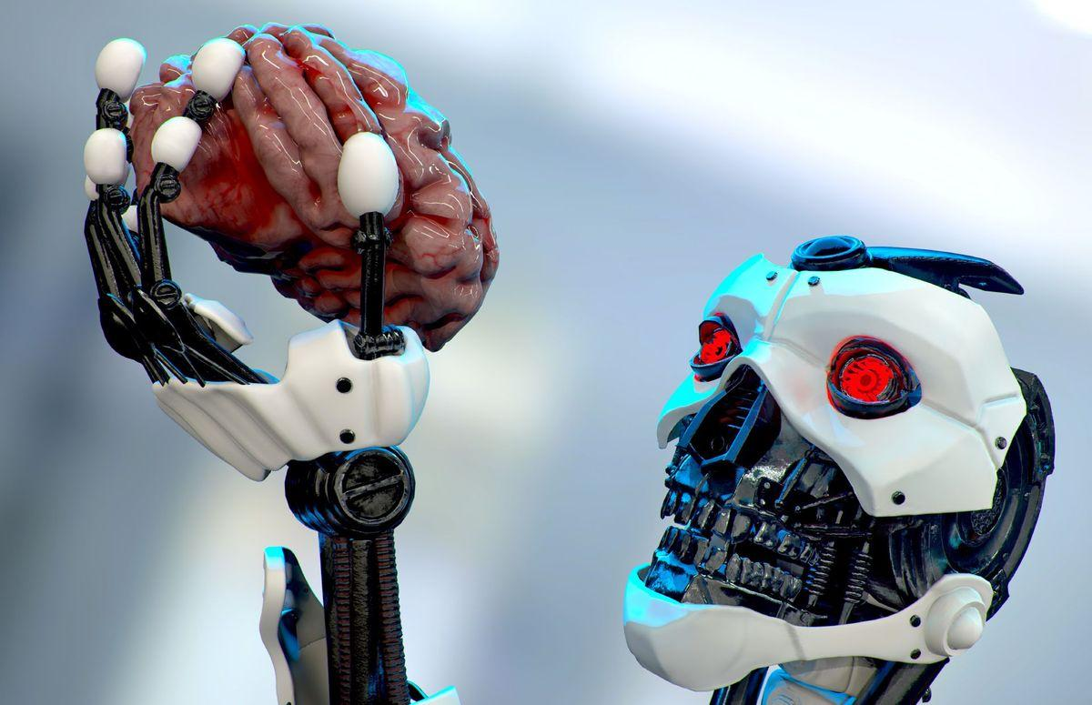
THIS?

Slide 5
Artificial intelligence (AI)... is a branch of computer science that aims to imbue software with the ability to analyze its environment using either predetermined rules and search algorithms, or pattern recognizing machine learning models, and then make decisions based on those analyses.
-Technopedia

Slide 6
So what’s the buzz about Machine Learning?
7

Slide 7
ML is a subset of AI
Machine learning is an application of artificial intelligence (AI) that provides systems the ability to automatically learn and improve from experience without being explicitly programmed. Machine learning focuses on the development of computer programs that can access data and use it learn for themselves.– ExpertSystem

Slide 8
Types of ML
Supervised Learning: Uses a set of input values with their labels to train your model. A common example could be using information about a house such as the number of rooms, size, location, to predict its final price. Since we already have information about the input variables (the rooms, size, location, etc) and final output variables (the house prices, we can train our model)

Slide 9
Types of ML
Unsupervised Learning: Sometimes we don’t have output labels available in our dataset and we wish to group our data into sections. A common example of such a scenario is having a movies dataset with lots of features on the movies such as their genre, rating, target audience, etc, and then grouping movies that are similar to each other with each other

Slide 10
Types of ML
Reinforcement Learning: These work similar to how a user may play a video game. The model is set up with a system of awards and penalties wherein, if the ‘player’ performs well he/she/it gets an award and if they don’t they are penalized. Over time, the model gets better and better at playing the game. Some examples include computers that can beat the world’s best players at the game of Go and Chess.

Slide 11
Common ML Algorithms
Linear Regression
Logistic Regression
Decision Tree
SVM
Naive Bayes
kNN
https://www.analyticsvidhya.com/blog/2017/09/common-machine-learning-algorithms/
K-Means
Random Forest
Dimensionality Reduction Algorithms
Gradient Boosting algorithms
GBM
XGBoost
LightGBM
CatBoost

Slide 12
Languages of the Future
Python:
Several libraries for accelerating your data science journey
Numpy
Scipy
Scikit-learn
TensorFlow
Keras
Pandas
Matplotlib

Slide 13
Google Drive Folder
I created a google drive folder with the following resources:
Personally recorded Videos for Introduction to Python
Videos on introduction to Neural Networks
Suggested courses for Machine Learning
Suggested Topics for Exploration this Summer
Template Google Colab Notebooks with most of the image preprocessing and data analysis work done for you
Will be updated with more resources as the summer progresses.
Will be sharing this with all of you after approval of the proprietary rights agreement.

Slide 14
Recommended Videos
But what is a Neural Network? | Deep learning, chapter 1
Gradient descent, how neural networks learn | Deep learning, chapter 2
What is backpropagation really doing? | Deep learning, chapter 3
Backpropagation calculus | Deep learning, chapter 4

Slide 15
Recommended Courses
Machine Learning Fundamentals
Coursera- Machine Learning by Andrew Ng.
This was my first introduction into the realm of machine learning. It’s an excellent way to get yourself up to speed with many concepts. He takes you from knowing almost nothing to being a near-expert within the field.
TensorFlow: Python Addons for accelerating your neural network creation journey
Coursera-Introduction to TensorFlow for Artificial Intelligence, Machine Learning, and Deep Learning
Good for a practical introduction to how to make your own neural networks. It skips over a lot of the math and conceptual understanding of networks but allows you to focus upon the hand-on building process.
Part 1 in a 4-course specialization. Feel free to explore more if you wish.

Slide 16
Recommended Review Papers
Cancer Diagnosis Using Deep Learning: A Bibliographic Review
Machine learning and clinical epigenetics: a review of challenges for diagnosis and classification
Artificial intelligence, machine learning, computer-aided diagnosis, and radiomics: advances in imaging towards to precision medicine
Machine Learning Approaches for Epidemiological Investigations of Food-Borne Disease Outbreaks
Machine Learning for Cancer Immunotherapies Based on Epitope Recognition by T Cell Receptors
The epidemiology and pathogenesis of coronavirus disease (COVID-19) outbreak

Slide 17
Topic Ideas
Classifying COVID vs. Non-COVID from CT-scans.
My model obtained 99% accuracy. I’d be happy to help you work on something similar
Lung Cancer Detection using CT scans
Predicting glaucoma using eye-scans
Cancer immunotherapies based on epitope recognition by T cell receptors
Epidemiology and pathogenesis of coronavirus outbreak

Slide 18
Thanks!
Any questions?
Feel Free to drop questions in the Q/A

Slide 19
Acknowledgments
https://www.analyticsvidhya.com/blog/2017/09/common-machine-learning-algorithms/
https://expertsystem.com/machine-learning-definition/
https://www.techopedia.com/definition/190/artificial-intelligence-ai

